Slide 1
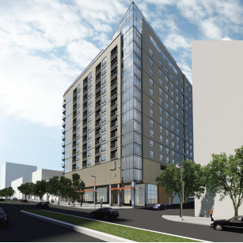
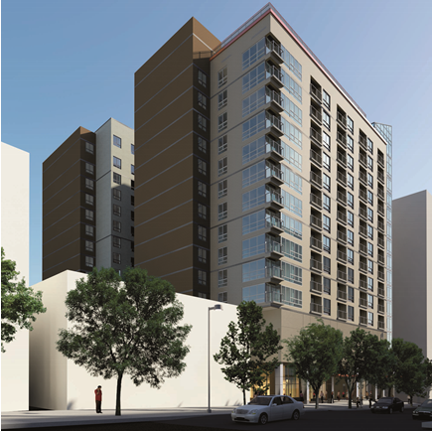
8621 Georgia Avenue
Silver Spring, MD
Nick Dastalfo ǀ Structural Option
Advisor: Dr. Thomas Boothby
April 13, 2015
Courtesy of Holbert Apple Associates
Courtesy of Holbert Apple Associates

Slide 2
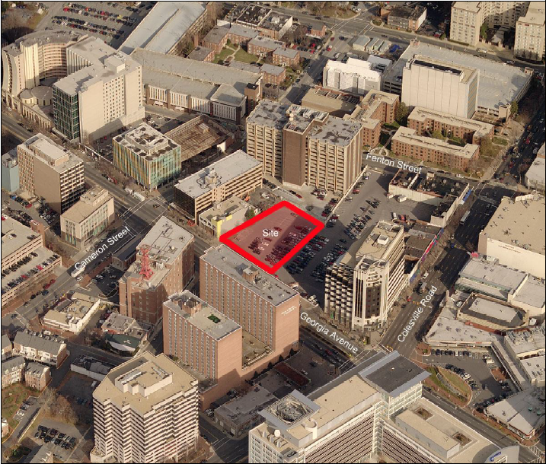
8621 Georgia Avenue
Building Introduction
  Statistics
  Gravity System
  Lateral System
Problem Statement & Solution
Composite Steel System
Lateral System
Foundation System
Ventilation System
Cost and Schedule Analysis
Conclusion
Building Introduction
Owner: FP Wilco, LLC
Structural Engineering: Holbert Apple Associates
Size: 347,000 GSF
Stories: 17
Height: 162 ft.
Cost: $52 Million
January 2015– February 2017
Courtesy of Holbert Apple Associates

Slide 3
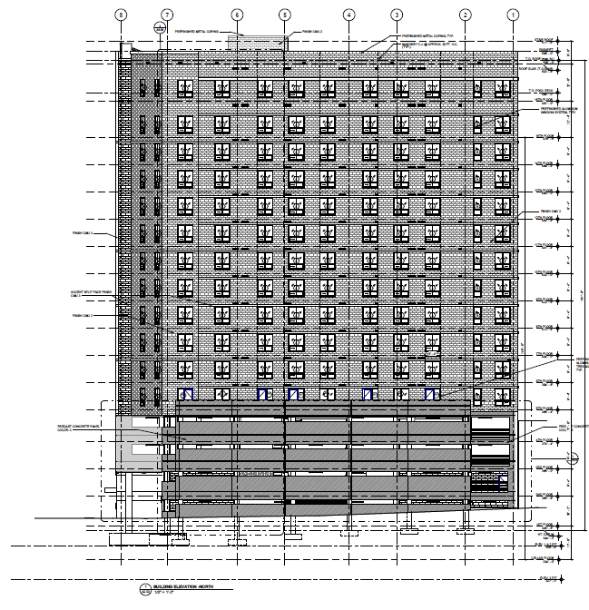
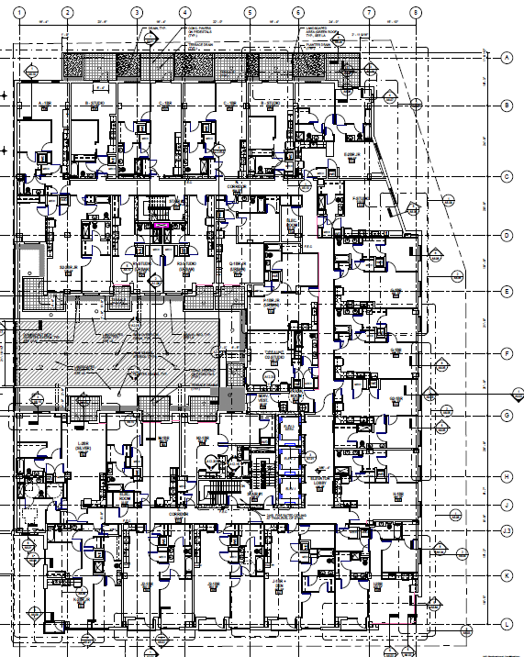
8621 Georgia Avenue
Building Introduction
  Statistics
  Gravity System
  Lateral System
Problem Statement & Solution
Composite Steel System
Lateral System
Foundation System
Ventilation System
Cost and Schedule Analysis
Conclusion
Building Introduction
Occupancy: 13 floors of apartments
4 floors of parking & retail, etc.
Features:
- Geometry change at level 5
- Green Roof
- Rooftop pool

Slide 4

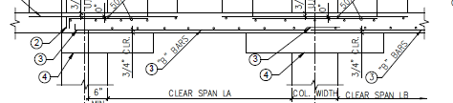
8621 Georgia Avenue
Building Introduction
  Statistics
  Gravity System
  Lateral System
Problem Statement & Solution
Composite Steel System
Lateral System
Foundation System
Ventilation System
Cost and Schedule Analysis
Conclusion
Gravity System
- 7.25” post-tensioned flat plate
- 8” slab w/ 4” drop panels

Slide 5
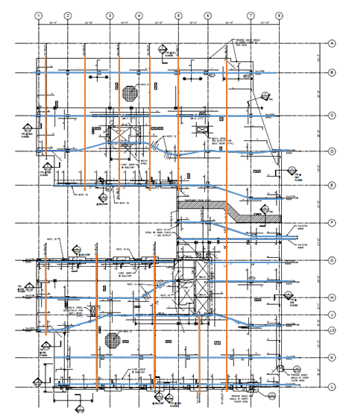

8621 Georgia Avenue
Building Introduction
  Statistics
  Gravity System
  Lateral System
Problem Statement & Solution
Composite Steel System
Lateral System
Foundation System
Ventilation System
Cost and Schedule Analysis
Conclusion
Gravity System
Two way PT system
-Banded Tendons
-Uniformly Distributed Tendons

Slide 6
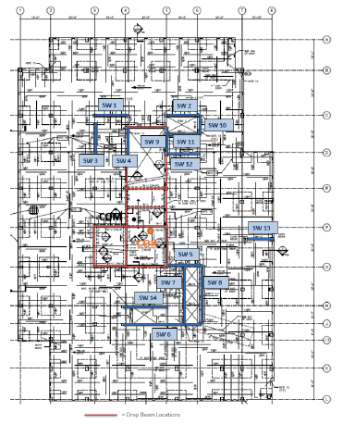
8621 Georgia Avenue
Building Introduction
  Statistics
  Gravity System
  Lateral System
Problem Statement & Solution
Composite Steel System
Lateral System
Foundation System
Ventilation System
Cost and Schedule Analysis
Conclusion
Lateral System
Ordinary Reinforced Concrete Shear Walls
- 12” or 14” thick
- located near stair and elevator cores
- Additional beams added in parking garage

Slide 7
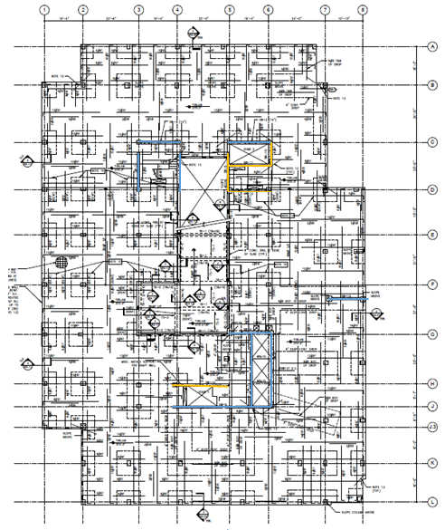
8621 Georgia Avenue
Building Introduction
  Statistics
  Gravity System
  Lateral System
Problem Statement & Solution
Composite Steel System
Lateral System
Foundation System
Ventilation System
Cost and Schedule Analysis
Conclusion
Lateral System
Ordinary Reinforced Concrete Shear Walls
- 12” or 14” thick
- located near stair and elevator cores
- Additional beams added in parking garage
- Shear Walls vary in height

Slide 8
8621 Georgia Avenue
Building Introduction
  Statistics
  Gravity System
  Lateral System
Problem Statement & Solution
Composite Steel System
Lateral System
Foundation System
Ventilation System
Cost and Schedule Analysis
Conclusion
Problem Statement
- Building is acceptable as designed
Proposed Solution
- Create a modular bay size and column locations
- Scenario: redesign the apartment levels in steel
- Design apartment levels using composite beams and girders
- Consider impact on:
- Architecture
- Foundations
- Vibrations
- Cost
- Move a level of parking garage below grade
- Investigate effects on foundations and lateral system
- Compare overall project cost

Slide 9
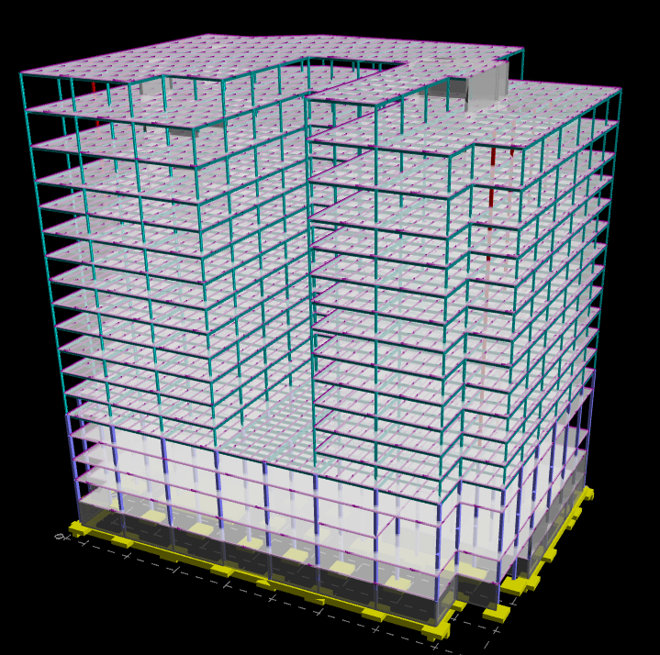
8621 Georgia Avenue
Building Introduction
Problem Statement & Solution
Composite Steel System
Lateral System
Foundation System
Ventilation System
Cost and Schedule Analysis
Conclusion
Gravity Redesign

Slide 10
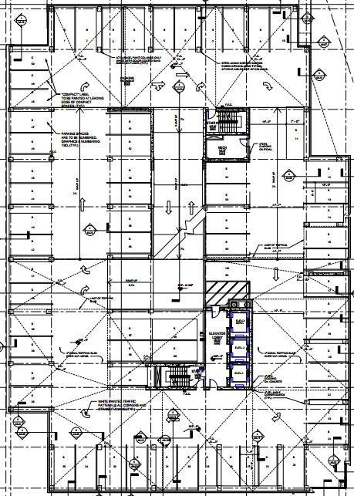
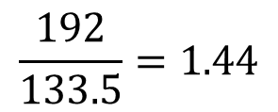
8621 Georgia Avenue
Building Introduction
Problem Statement & Solution
Composite Steel System
Lateral System
Foundation System
Ventilation System
Cost and Schedule Analysis
Conclusion
Typical Bay/Columns
Square → Rectangular Bays
Move Columns onto grid
Mirror building proportions in bay proportions
133.5 ft.
192 ft.
$$\frac{192}{133.5}=1.44$$

Slide 11
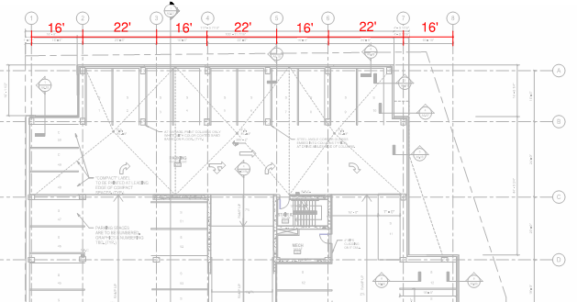
8621 Georgia Avenue
Building Introduction
  Statistics
  Gravity System
  Lateral System
Problem Statement & Solution
Composite Steel System
Lateral System
Foundation System
Ventilation System
Cost and Schedule Analysis
Conclusion
Typical Bay/Columns
Square → Rectangular Bays
Move Columns onto grid
Mirror building proportions in bay proportions
- Re-Orient Parking Spaces from 90° to 60°
Parking Space Orientation | Minimum Throughway Width
90° spaces | 24 feet
60° spaces | 18 feet

Slide 12

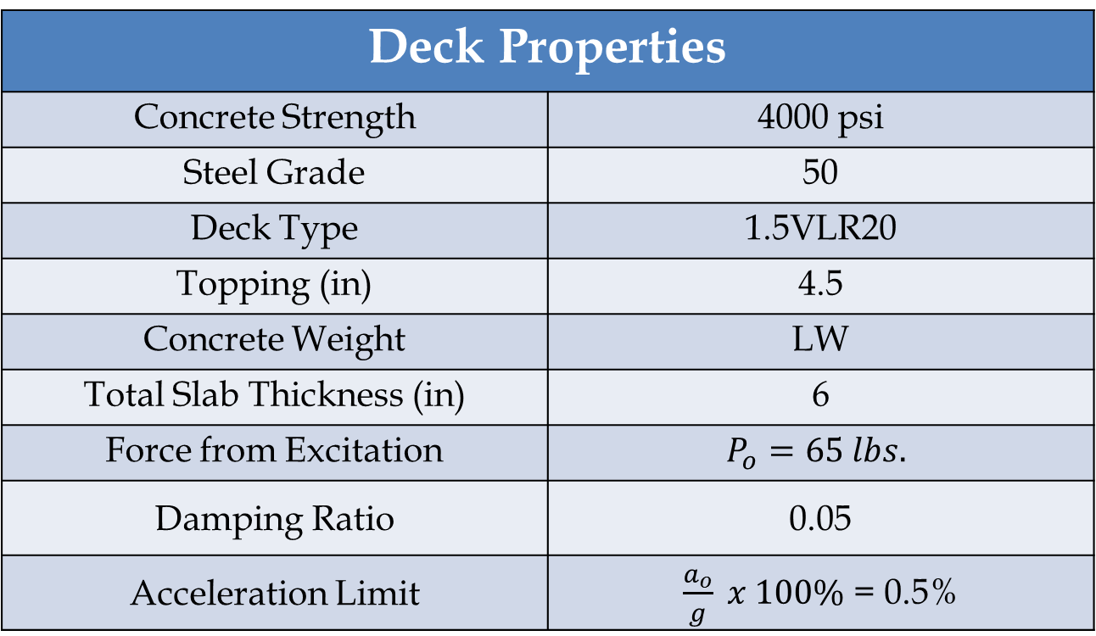
8621 Georgia Avenue
Building Introduction
Problem Statement & Solution
Composite Steel System
  Vibrations Analysis
  Beam Layout
  Beam/Column Design
Lateral System
Foundation System
Ventilation System
Cost and Schedule Analysis
Conclusion
Vibrations Analysis
Vibrations due to human walking activity
Minimize accelerations in the floor
Deck Properties
Concrete Strength | 4000 psi
Steel Grade | 50
Deck Type | 1.5VLR20
Topping (in) | 4.5
Concrete Weight | LW
Total Slab Thickness (in) | 6
Force from Excitation | $$P_{o}=65 lbs.$$
Damping Ratio | 0.05
Acceleration Limit | $\frac{a_{o}}{g} x 100\%$ = 0.5%
18’
Design Inputs:
  Deck: 1.5VLR20
  4.5” LW Topping
  6’ beam spacing
24’

Slide 13
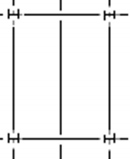
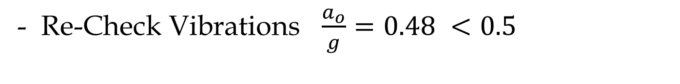
8621 Georgia Avenue
Building Introduction
Problem Statement & Solution
Composite Steel System
  Vibrations Analysis
  Beam Layout
  Beam/Column Design
Lateral System
Foundation System
Ventilation System
Cost and Schedule Analysis
Conclusion
Vibrations Analysis
- Increasing beam sizes reduced steel utilization
- Increase Deck Gauge and Space beams further
- 1.5VLR16
- 9’ foot beam spacing
- Increase Interaction to 0.75
- Limited by deflections
- Re-Check Vibrations $\frac{a_{o}}{g}=0.48 <0.5$

Slide 14
8621 Georgia Avenue
Building Introduction
Problem Statement & Solution
Composite Steel System
  Vibrations Analysis
  Beam Layout
  Beam/Column Design
Lateral System
Foundation System
Ventilation System
Cost and Schedule Analysis
Conclusion
Beam Layout
Long Direction
Short Direction

Slide 15
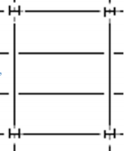
8621 Georgia Avenue
Building Introduction
Problem Statement & Solution
Composite Steel System
  Vibrations Analysis
  Beam Layout
  Beam/Column Design
Lateral System
Foundation System
Ventilation System
Cost and Schedule Analysis
Conclusion
Beam Layout
Long Direction
Short Direction
  Deck can not support single mid-span infill beam

Slide 16
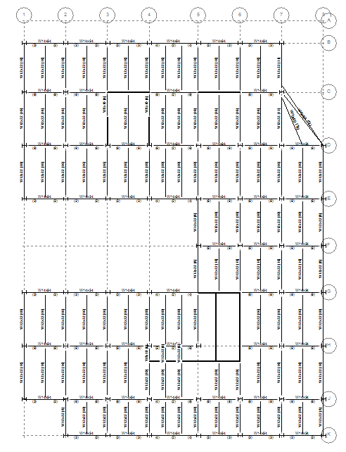
8621 Georgia Avenue
Building Introduction
Problem Statement & Solution
Composite Steel System
  Vibrations Analysis
  Beam Layout
  Beam/Column Design
Lateral System
Foundation System
Ventilation System
Cost and Schedule Analysis
Conclusion
Beam Layout
Long Direction selected
Beam Orientation
 | Steel Weight (tons) | # of Members | # of studs
Long | 590.9 | 2,220 | 25,093
Short | 627.3 | 2,577 | 28,387

Slide 17
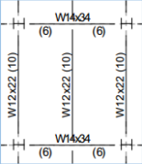
8621 Georgia Avenue
Building Introduction
Problem Statement & Solution
Composite Steel System
  Vibrations Analysis
  Beam Layout
  Beam/Column Design
Lateral System
Foundation System
Ventilation System
Cost and Schedule Analysis
Conclusion
Beam Layout
Long Direction selected
Beam Orientation
 | Steel Weight (tons) | # of Members | # of studs
Long | 590.9 | 2,220 | 25,093
Short | 627.3 | 2,577 | 28,387

Slide 18
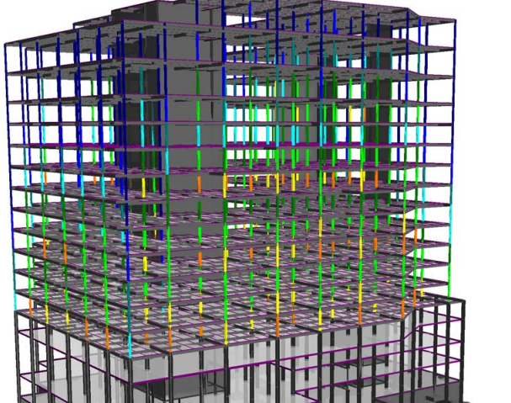
8621 Georgia Avenue
Building Introduction
Problem Statement & Solution
Composite Steel System
  Vibrations Analysis
  Beam Layout
  Beam/Column Design
Lateral System
Foundation System
Ventilation System
Cost and Schedule Analysis
Conclusion
Column Design
W10 or W12 columns
  Column depth constant through building height
  Sizes vary along height for efficiency
Spliced every two floors

Slide 19
8621 Georgia Avenue
Building Introduction
Problem Statement & Solution
Composite Steel System
  Vibrations Analysis
  Beam Layout
  Beam/Column Design
Lateral System
Foundation System
Ventilation System
Cost and Schedule Analysis
Conclusion
Column Design
Exterior Column – H8 |  |  | Interior Column – D6
Floor | Size | Interaction | Floor | Size | Interaction
10-16 | W10x33 | 0.20 – 0.93 | 13-16 | W12x40 | 0.35 – 0.94
7-9 | W10x45 | 0.76 – 0.95 | 10-12 | W12x58 | 0.72 – 0.98
4-6 | W10x54 | 0.81 – 0.94 | 7-9 | W12x79 | 0.78 - 0.97
 |  |  | 4-6 | W12x106 | 0.79 - 0.91

Slide 20
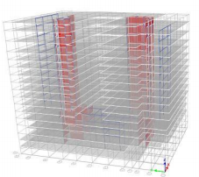
8621 Georgia Avenue
Building Introduction
Problem Statement & Solution
Composite Steel System
Lateral System
Foundation System
Ventilation System
Cost and Schedule Analysis
Conclusion
Lateral System

Slide 21
8621 Georgia Avenue
Building Introduction
Problem Statement & Solution
Composite Steel System
Lateral System
  Layout
  Shear Walls
  Moment Frames
Foundation System
Ventilation System
Cost and Schedule Analysis
Conclusion
Lateral Layout
-Reduced Building Weight
-Seismic forces decrease
-Wind Controls
-Building height unchanged with less floors
-Story forces increase

Slide 22
8621 Georgia Avenue
Building Introduction
Problem Statement & Solution
Composite Steel System
Lateral System
  Layout
  Shear Walls
  Moment Frames
Foundation System
Ventilation System
Cost and Schedule Analysis
Conclusion
Lateral Layout
-Reduced Building Weight
-Seismic forces decrease
-Wind Controls
-Building height unchanged with less floors
-Story forces increase

Slide 23
8621 Georgia Avenue
Building Introduction
Problem Statement & Solution
Composite Steel System
Lateral System
  Layout
  Shear Walls
  Moment Frames
Foundation System
Ventilation System
Cost and Schedule Analysis
Conclusion
Lateral Layout
-Reduced Building Weight
-Seismic forces decrease
-Wind Controls
-Building height unchanged with less floors
-Story forces increase

Slide 24
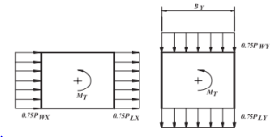
8621 Georgia Avenue
Building Introduction
Problem Statement & Solution
Composite Steel System
Lateral System
  Layout
  Shear Walls
  Moment Frames
Foundation System
Ventilation System
Cost and Schedule Analysis
Conclusion
Lateral Layout
- Remove isolated shear wall
-architectural conflicts
-ineffective in resisting torsion
- Check without SW#13
Drift due to Wind Case 2 in the X Direction
Load Case | Max Drift (in) | Allowable Drift (in) | Pass / Fail
X Direction (+M) | 2.840 | 4.83 | PASS
X Direction (-M) | 4.822 | 4.83 | RE-EVALUATE

Slide 25
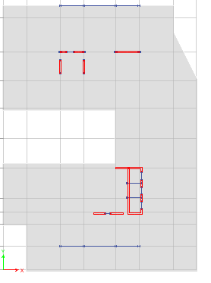
8621 Georgia Avenue
Building Introduction
Problem Statement & Solution
Composite Steel System
Lateral System
  Layout
  Shear Walls
  Moment Frames
Foundation System
Ventilation System
Cost and Schedule Analysis
Conclusion
Lateral Layout
-Remove isolated shear wall
-architectural conflicts
-ineffective
-Add Moment Frames
-reduce displacement
-reduce torsion
Drift due to Wind Case 2 in the X Direction
Load Case | Max Drift (in) | Allowable Drift (in) | Pass / Fail
X Direction (+M) | 2.80 | 4.83 | PASS
X Direction (-M) | 4.76 | 4.83 | PASS

Slide 26
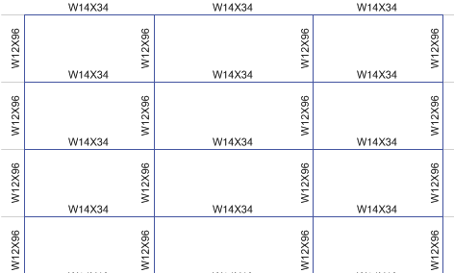
8621 Georgia Avenue
Building Introduction
Problem Statement & Solution
Composite Steel System
Lateral System
  Layout
  Shear Walls
  Moment Frames
Foundation System
Ventilation System
Cost and Schedule Analysis
Conclusion
Lateral Layout
-Remove isolated shear wall
-architectural conflicts
-ineffective
-Add Moment Frames
-reduce displacement
-reduce torsion

Slide 27
8621 Georgia Avenue
Building Introduction
Problem Statement & Solution
Composite Steel System
Lateral System
Foundation System
Ventilation System
Cost and Schedule Analysis
Conclusion
Foundation System

Slide 28
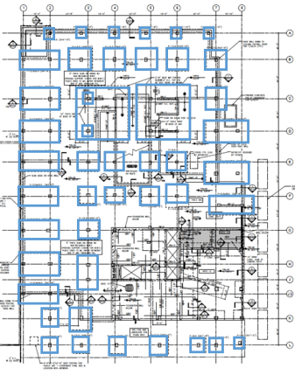
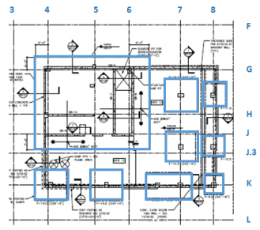
8621 Georgia Avenue
Building Introduction
Problem Statement & Solution
Composite Steel System
Lateral System
Foundation System
Ventilation System
Cost and Schedule Analysis
Conclusion
Foundation System
Reduced Building Weight → Reduce Footing Size
- Shared Column Footings → Two individual footings

Slide 29
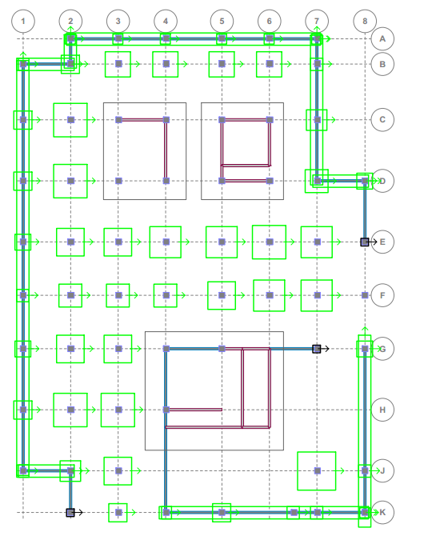
8621 Georgia Avenue
Building Introduction
Problem Statement & Solution
Composite Steel System
Lateral System
Foundation System
Ventilation System
Cost and Schedule Analysis
Conclusion
Foundation System
Reduced Building Weight → Reduce Footing Size
- Shared Column Footings → Two individual footings

Slide 30
8621 Georgia Avenue
Building Introduction
Problem Statement & Solution
Composite Steel System
Lateral System
Foundation System
Ventilation System
Cost and Schedule Analysis
Conclusion
Foundation System
Foundation System Comparison
 | Concrete (CY) | Formwork (SFCA) | Steel (tons)
Existing | 1762.4 | 10599.5 | 69.48
Re-Designed | 1105.0 | 7094.7 | 56.14
% Decrease | 37.3% | 33.1% | 19.2%

Slide 31
8621 Georgia Avenue
Building Introduction
Problem Statement & Solution
Composite Steel System
Lateral System
Foundation System
Ventilation System
Cost and Schedule Analysis
Conclusion
Ventilation System Design

Slide 32
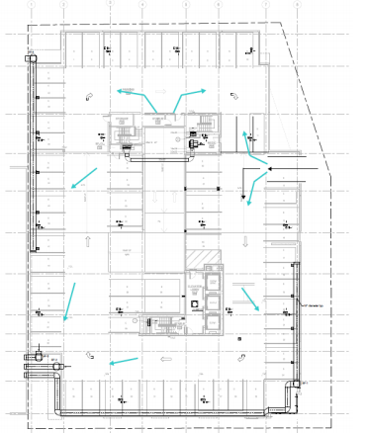
8621 Georgia Avenue
Building Introduction
Problem Statement & Solution
Composite Steel System
Lateral System
Foundation System
Ventilation System
Cost and Schedule Analysis
Conclusion
Ventilation System
- Underground parking → Need to exhaust air
- 4 Exhaust fans
- Rely on air pressure to move clean air
- Air exhausted safely away from pedestrian area.

Slide 33
8621 Georgia Avenue
Building Introduction
Problem Statement & Solution
Composite Steel System
Lateral System
Foundation System
Ventilation System
Cost and Schedule Analysis
Conclusion
Cost Comparison

Slide 34
8621 Georgia Avenue
Building Introduction
Problem Statement & Solution
Composite Steel System
Lateral System
Foundation System
Ventilation System
Cost and Schedule Analysis
Conclusion
Cost Comparison
Based on Cost Information from RS Means
Steel System Cost Analysis
Redesigned System | Cost | Net Difference
Steel Framing | $9,452,439 | - $3,400,736
Foundation | $1,028,110 | + $721,356
Ventilation | $52,274 | - $52,274
Additional Excavation | $149,804 | - $149,804
Parking Spaces | $79,380 | - $79,380
Totals | $10,762,007 | -$2,960,837
- Cost Savings from Foundation Reduction

Slide 35
8621 Georgia Avenue
Building Introduction
Problem Statement & Solution
Composite Steel System
Lateral System
Foundation System
Ventilation System
Cost and Schedule Analysis
Conclusion
Cost Comparison
6% Project Cost Increase
23% Structural Increase
Total System Cost
Steel | Concrete
$10,762,007 | $7,801,170
Per Square Foot Cost
Steel | Concrete
$43.11 | $31.25

Slide 36
8621 Georgia Avenue
Building Introduction
Problem Statement & Solution
Composite Steel System
Lateral System
Foundation System
Ventilation System
Cost and Schedule Analysis
Conclusion
Conclusion
Created a modular bay size with minimal architectural impact
- Designed a steel gravity system with vibration controlling characteristics
- Re-design foundation system
- Provide underground parking
Determine the feasibility of a steel system
    Project cost increase
Courtesy of Holbert Apple Associates

Slide 37
8621 Georgia Avenue
Building Introduction
Problem Statement & Solution
Composite Steel System
Lateral System
Foundation System
Ventilation System
Cost and Schedule Analysis
Conclusion
Acknowledgments
A Very Special Thanks to:
    Holbert Apple Associates
        David Holbert & David Smith
    AE Faculty , especially Thomas Boothby
    Family, Friends, and Classmates
    Jesus Christ

Slide 38
8621 Georgia Avenue
Building Introduction
Problem Statement & Solution
Composite Steel System
Lateral System
Foundation System
Ventilation System
Cost and Schedule Analysis
Conclusion
Questions and Comments?

Slide 39
8621 Georgia Avenue
Building Introduction
Problem Statement & Solution
Composite Steel System
Lateral System
Foundation System
Ventilation System
Cost and Schedule Analysis
Conclusion
Questions and Comments?

